Slide 1

F-ALERT : FIRE DISASTER MANAGEMENT
USING MACHINE LEARNING
GROUP NO : 26
Purva Gharat
501519
Elvis D’Costa
501508
Jincy Jacob
501524
Kunal Das
501511

Slide 2
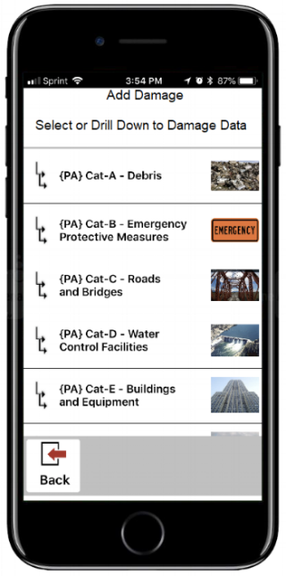
PROBLEM STATEMENT
‘We aim to predict the occurrence of an hazard,
particularly fire- hazards, beforehand by
analysing the collected data of a particular
area and suggest the most effective mitigation
plan.’

Slide 3
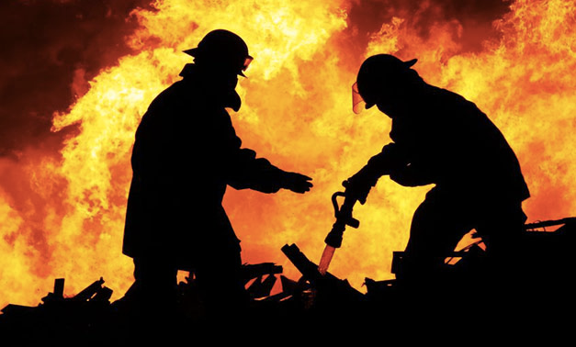
INTRODUCTION
Estimation of USD 7 trillion worth of economic damage and 8 million deaths via natural disasters have occured since start of 20th century.
Now if we consider fire hazards,
within the 6 months of 2018, Mumbai has seen 12 major fires and 22 deaths.
Disaster management includes 3 basic phases: preparedness, response, and recovery.
The efficient data collection, archiving and analytics is essential for effective
disaster management (Big data can play a major role).

Slide 4


LITERATURE SURVEY
Conclusions from our survey :
The Role of Big Data in Disaster Management
A Mobile Disaster Management System on Mobile Phone using Google maps/Openstreet
Forest Fire Prediction and Alert System Using Big Data Technology
A Secure Big Data Stream Analytics Framework for Disaster Management on the Cloud

Slide 5
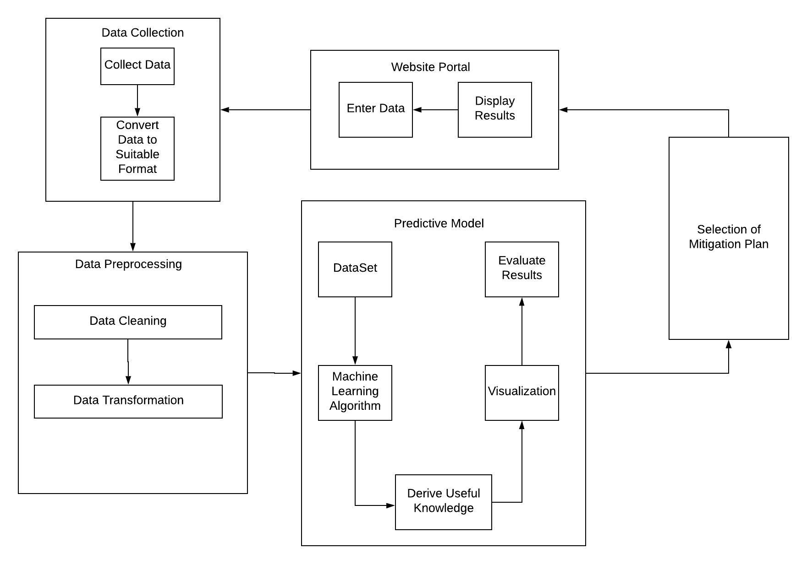
SYSTEM DESIGN

Slide 6

Formula for Calculating Weights
Feature Weight = Feature present count * log$\left(\frac{\text{total} \text{tuples}}{\text{Feature} \text{present} \text{count}}\right)$
Formula for Calculating Severity Score
Severity Score = feature1*weight1 + feature2*weight2 + feature3*weight3

Slide 7
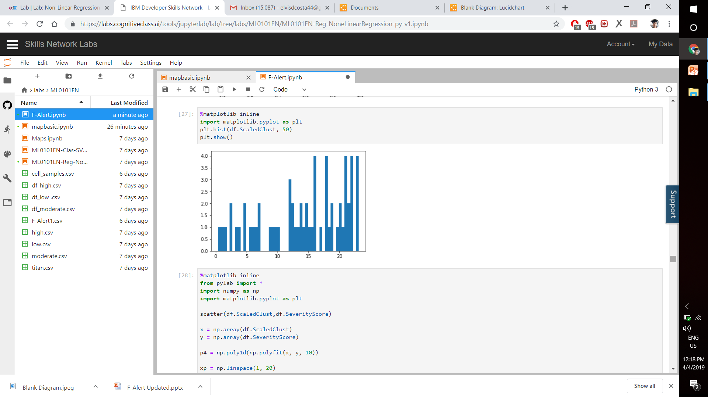
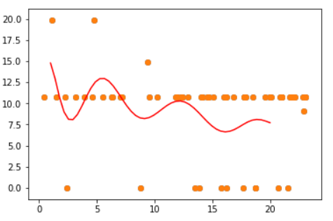
Occurrence VS Severity

Slide 8
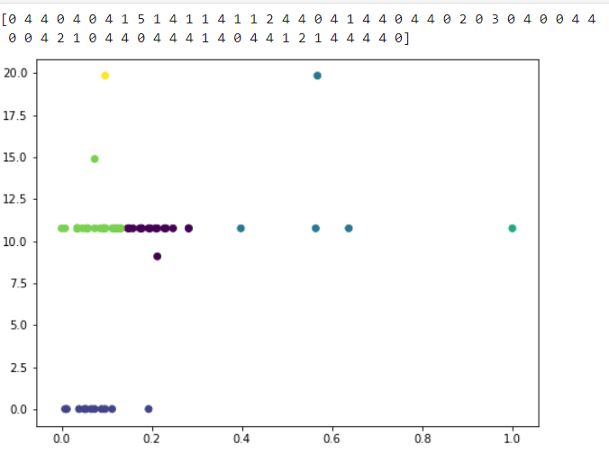
Clustering For Determining Different Zones

Slide 9
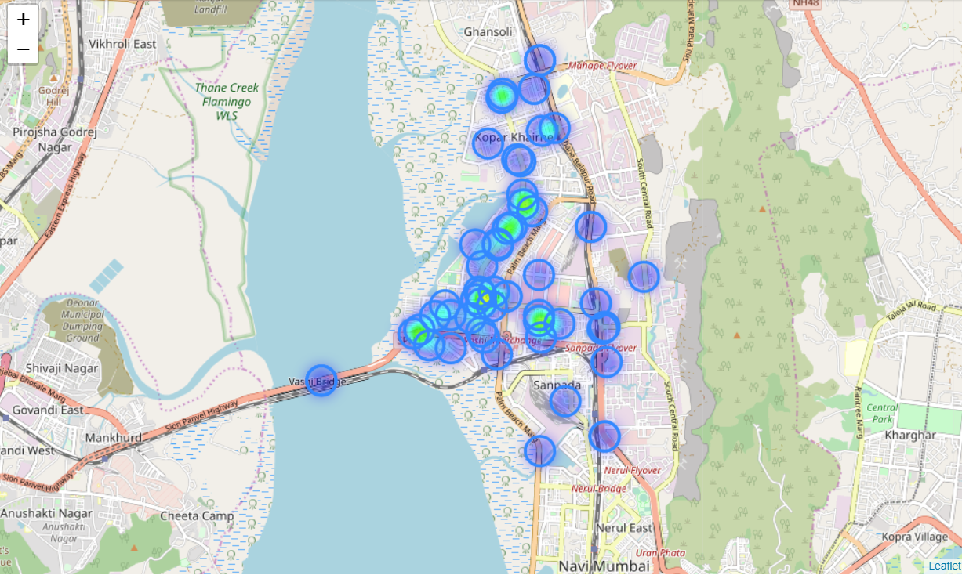
Visualization of Occurrence on Maps

Slide 10
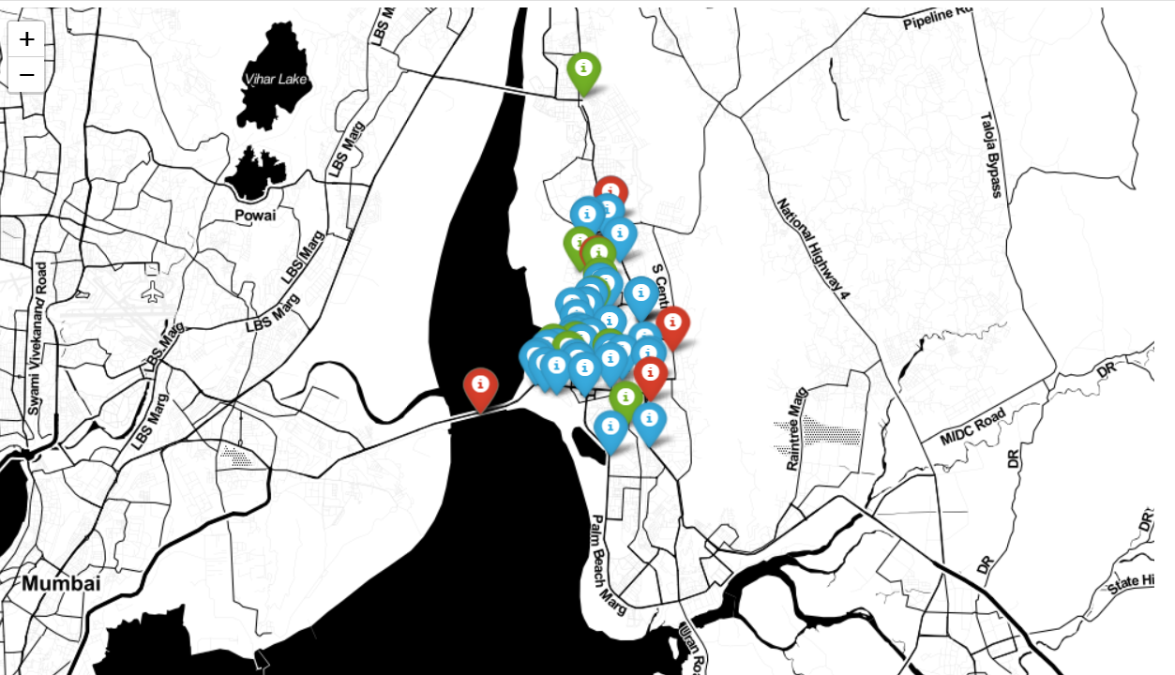
Visualization of Severity on Maps

Slide 11
Thank You

